Slide 1








Vehicle-Silhouettes
DATA MINING

Slide 2


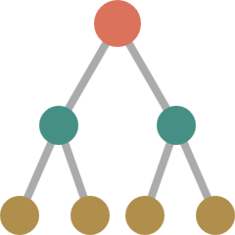

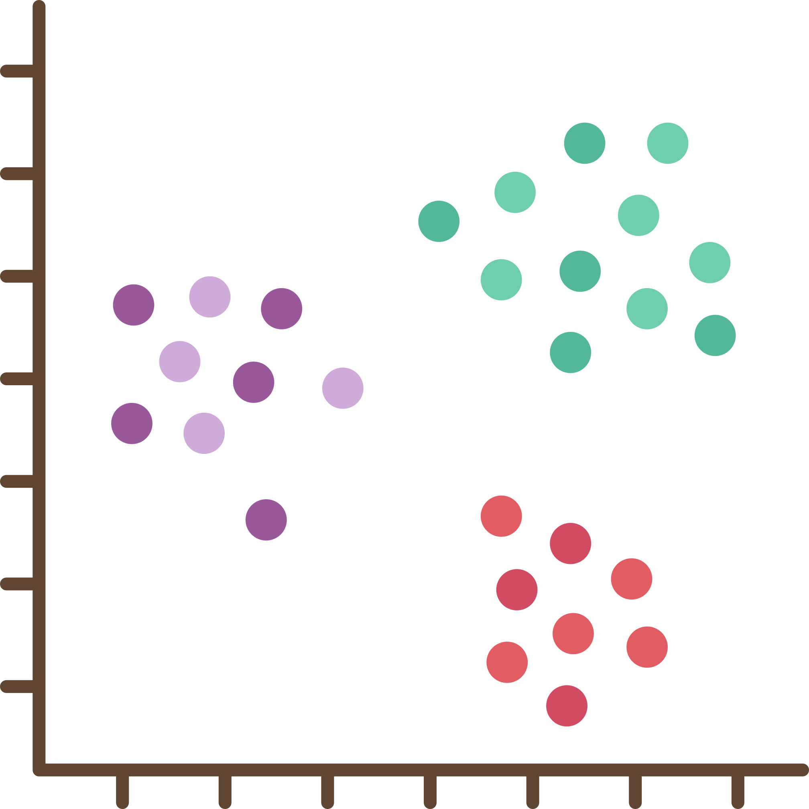
Understanding vehicle shapes is really important in the real world for things like making traffic flow better and keeping an eye on things. Our project is all about using the shapes of vehicles to figure out if they're cars, vans, or buses. Getting this right is super important for managing traffic, keeping an eye on things with cameras, and planning transportation. We're working on a smart system to make sure we can tell what kind of vehicle is which, making everything run smoother in industries that need to know exactly what kind of vehicles are around.
Problem

Slide 3



Data
ATTRIBUTES
Our dataset consist of:
'compactness'
'circularity'
'distance_circularity'
'radius_ratio'
'pr.axis_aspect_ratio'
'max.length_aspect_ratio'
'scatter_ratio'
'elongatedness'
'pr.axis_rectangularity'
'max.length_rectangularity'
'scaled_variance'
'scaled_variance.1'
'scaled_radius_of_gyration'
'scaled_radius_of_gyration.1'
'skewness_about'
'skewness_about.1'
'skewness_about.2'
'hollows_ratio'
‘class’
NUMBER OF ROW
NUMBER OF COLUMN
846
19

Slide 4
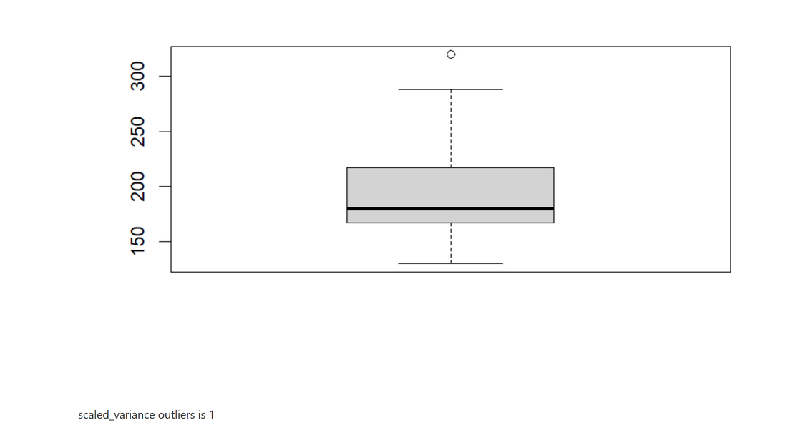
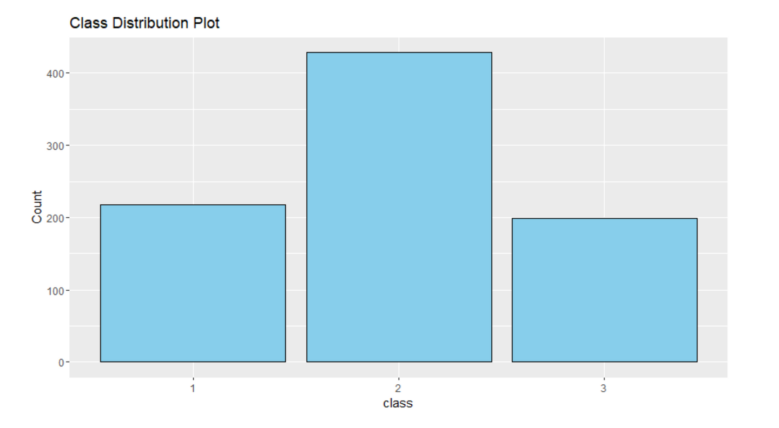
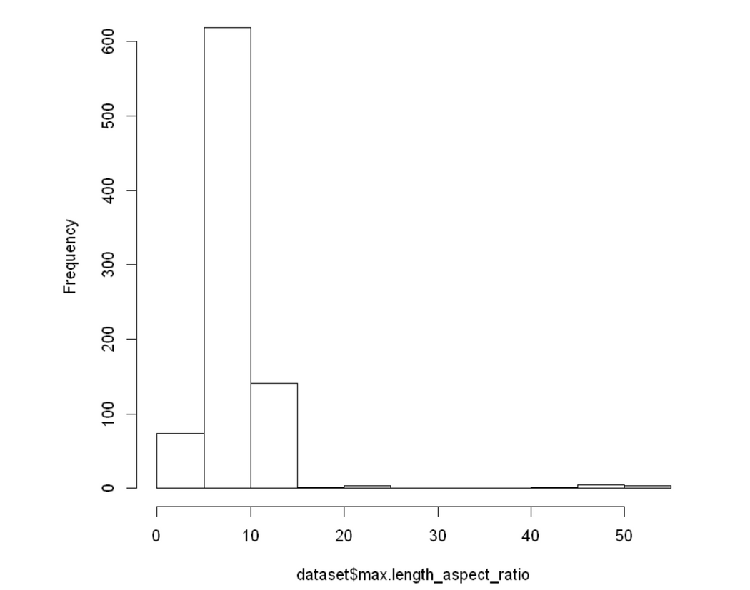
Data
graphs

Slide 5

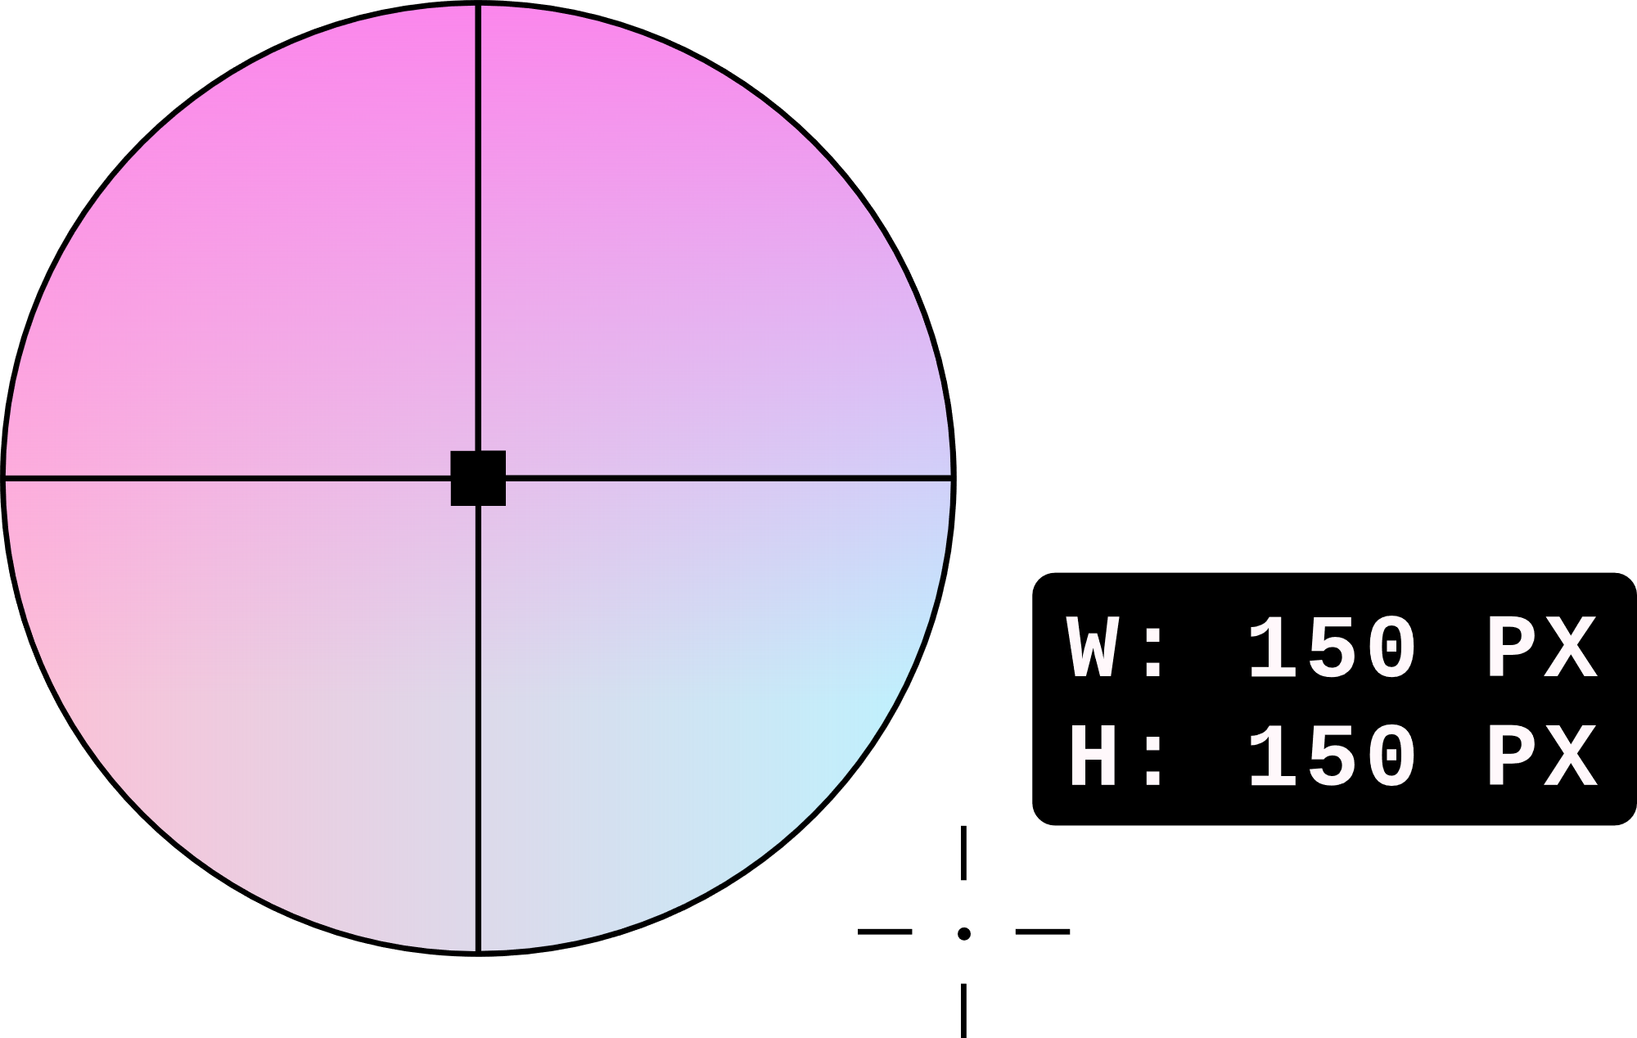
Data preprocessing is a crucial step in data analysis and machine learning that involves cleaning and transforming raw data into a format suitable for analysis or model training.
Data
preprocessing

Slide 6

Preprocessing stage
NORMALIZATION
We identified columns with wide ranges that could impact our dataset and adjusted them to a similar scale through normalization. This helps ensure that no single column dominates the analysis due to its larger range.
DEALING WITH MISSING VALUES
ENCODING CATEGORICAL DATA
We have removed the missing values and set it as median to ensures that we maintain the overall central tendency of the dataset, minimizing the potential distortion of the size-related information.
DISCRETIZATION
Since our dataset is mainly size related variables its best to retain them as continuous variable without discretization.
FEATURE SELECTION
For feature selection, we looked at which attribute had the strongest connection with the others and decided to remove it to avoid unnecessary repetition or duplication.

Slide 7
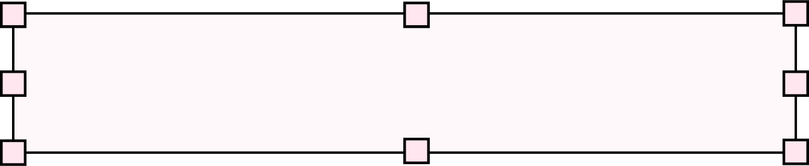

CLASSIFICATION
Data mining
technique
CLUSTERING
The goal of employing data mining techniques is to uncover significant patterns, trends, or knowledge within extensive datasets. In our project, we utilized the classification and clustering techniques to achieve this objective.

Slide 8
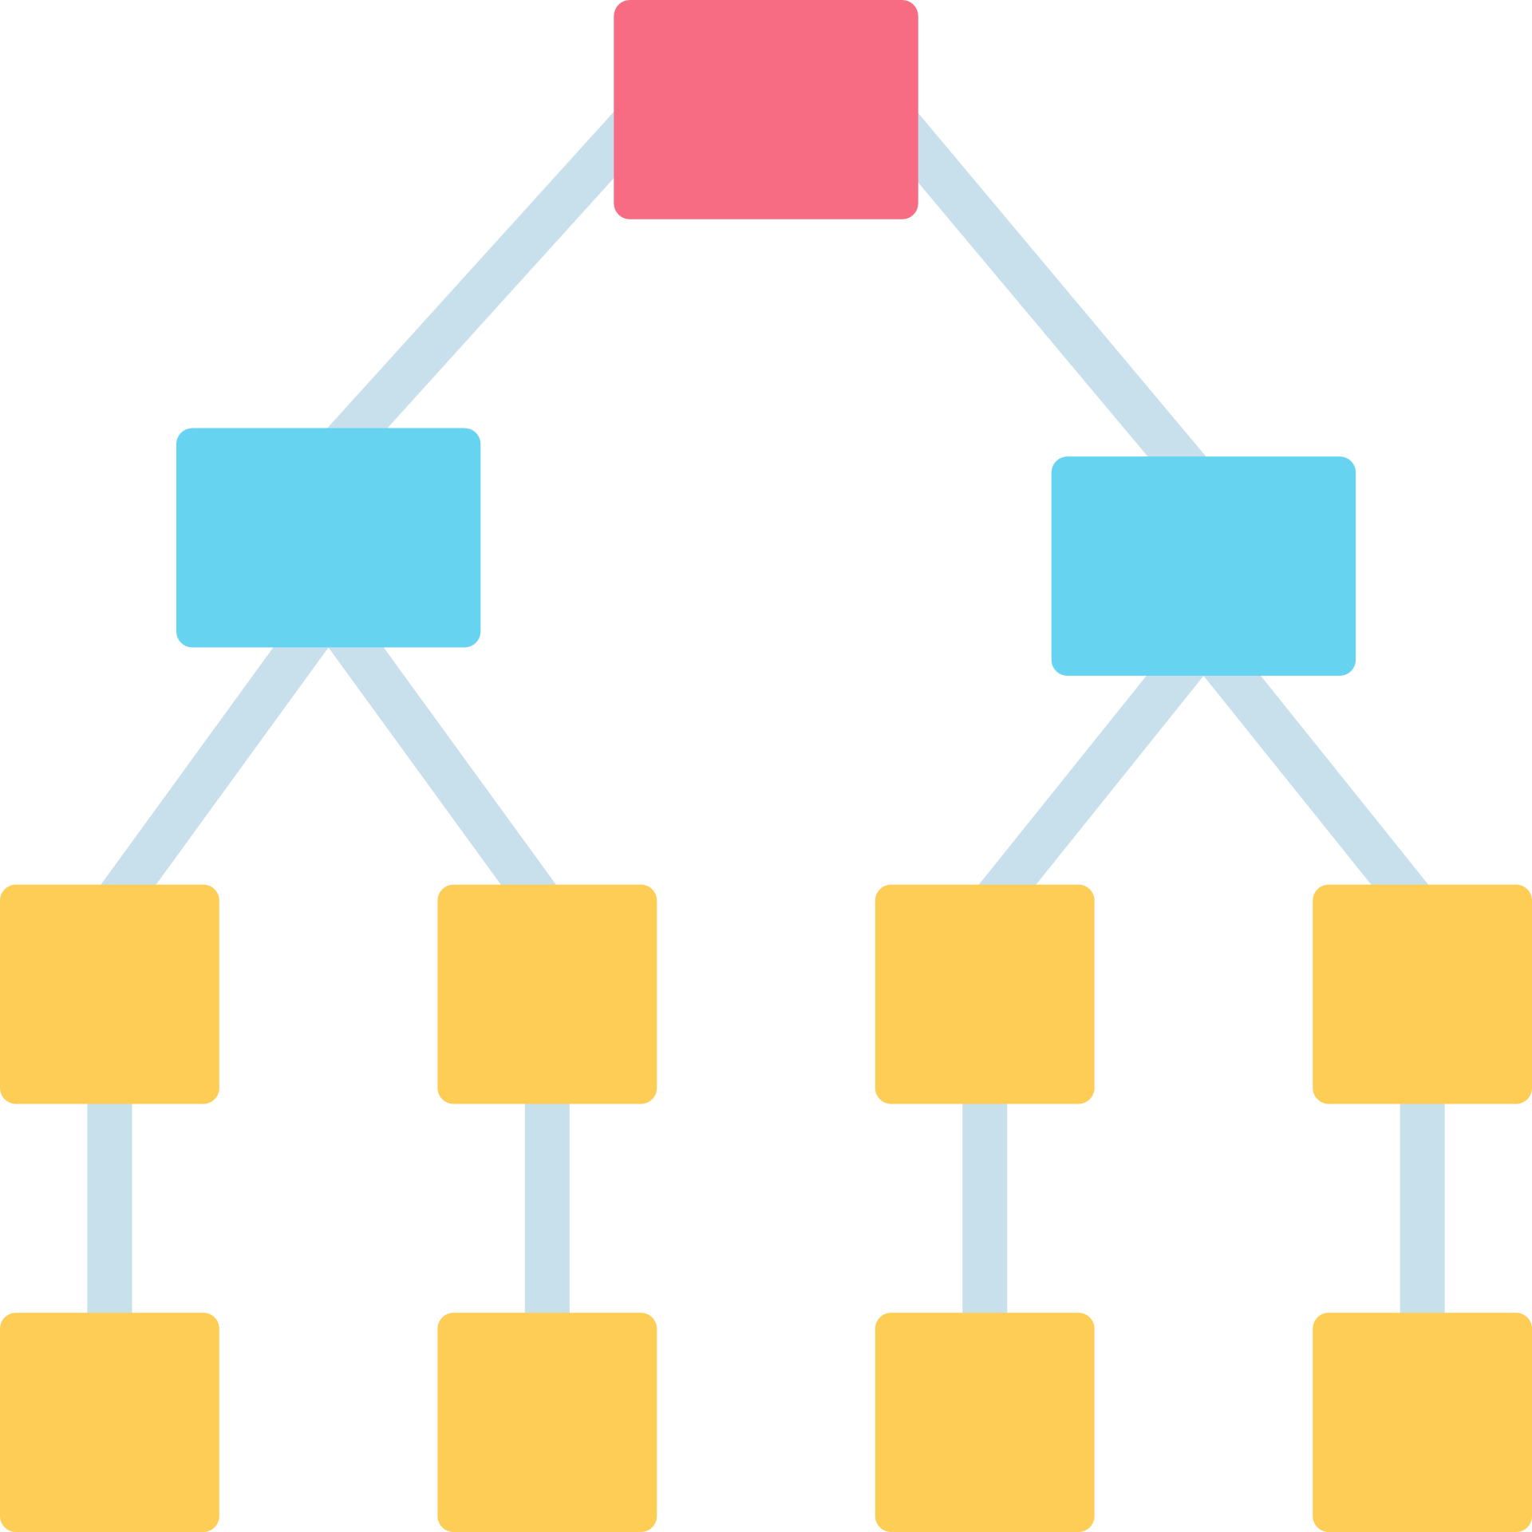
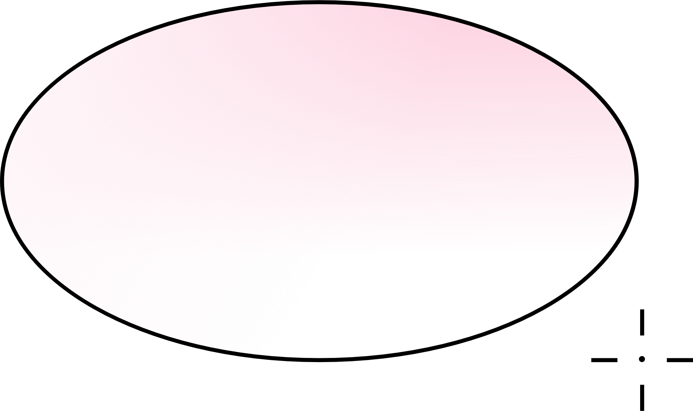
Classification
Classification, a form of supervised learning, relies on predefined class labels. In our project, we trained our model using these labels to predict the category (van, car, bus) based on given attributes.

Slide 9
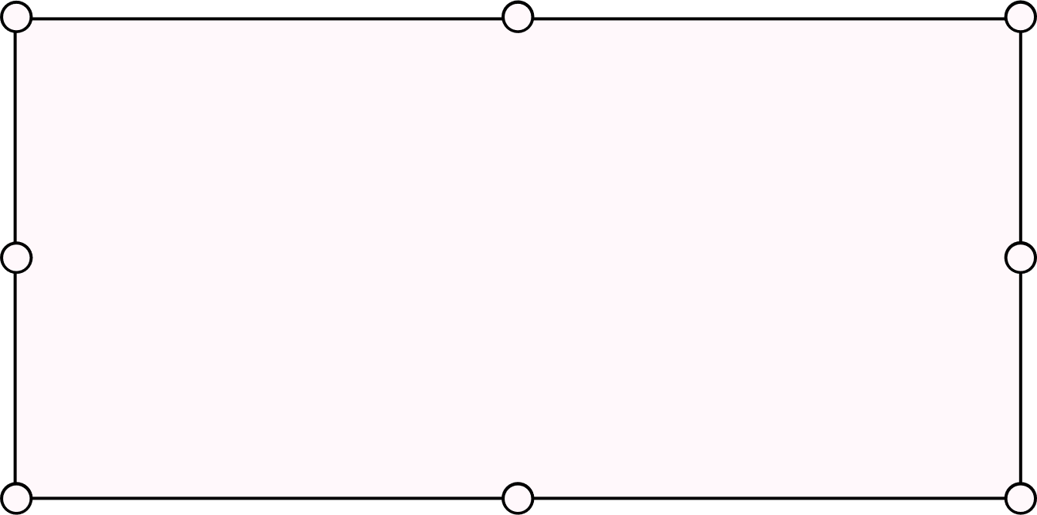

We divided our dataset into three separate parts and applied three distinct attribute selection measures—gain ratio, Gini index, and information gain. We then examined the outcomes and compared the results to understand how each measure affected our analysis.
What we did:

Slide 10
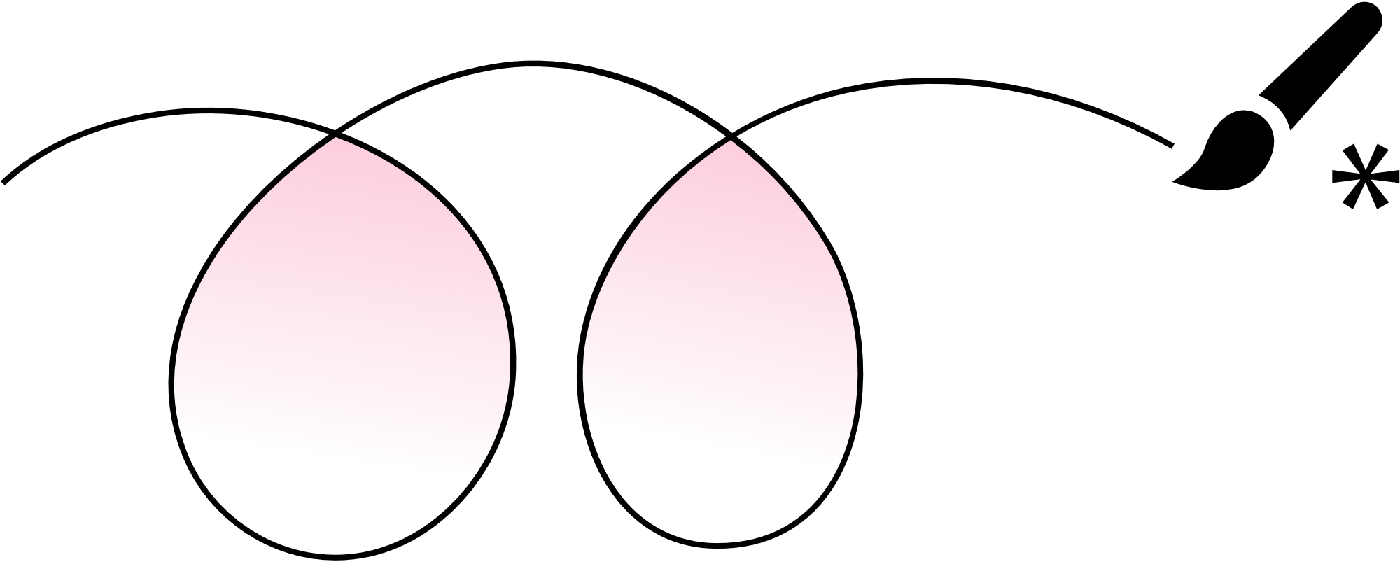
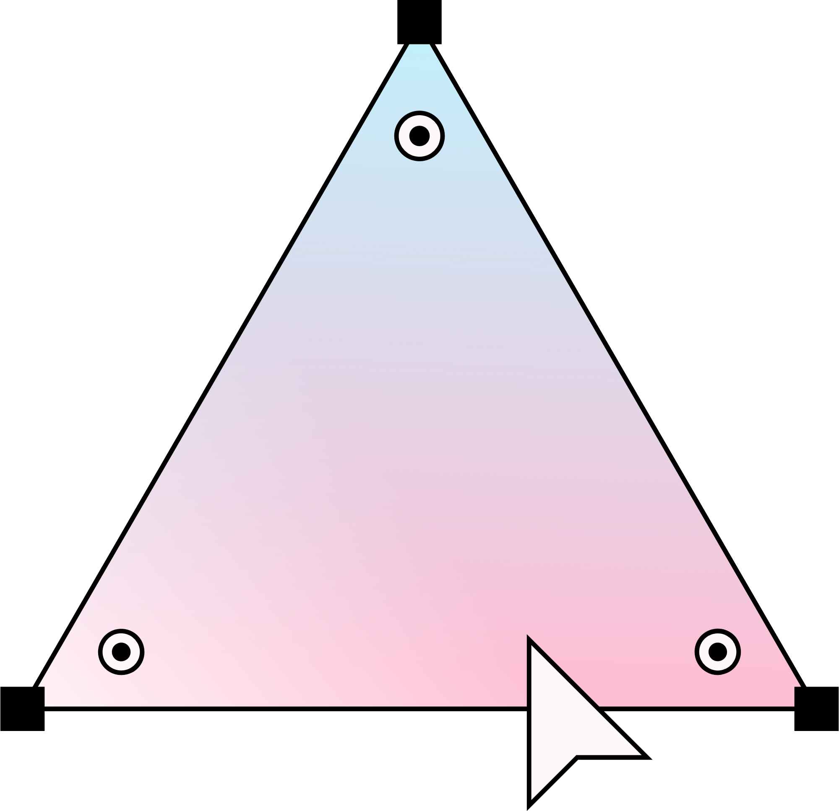
Findings
Based on our findings we found out that the Gini Index emerges as the most reliable and accurate metric for this classification task. Based on accuracy and stability and precision.

Slide 11
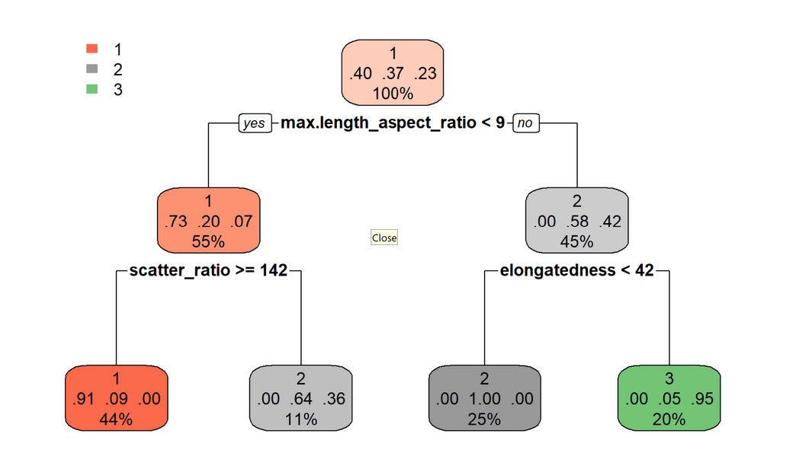
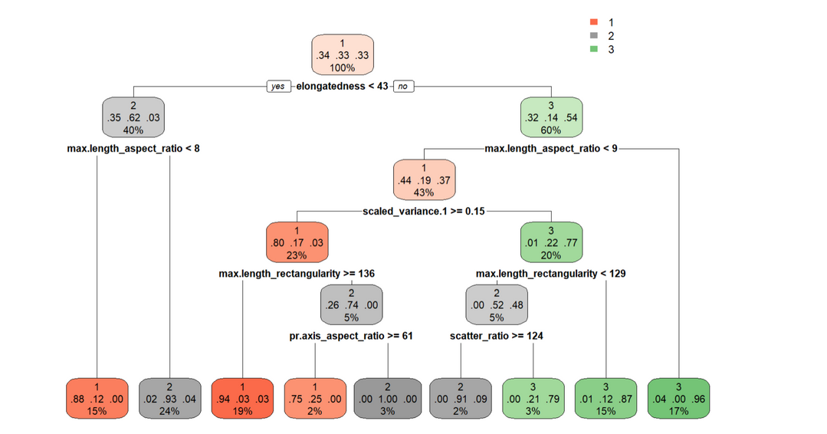
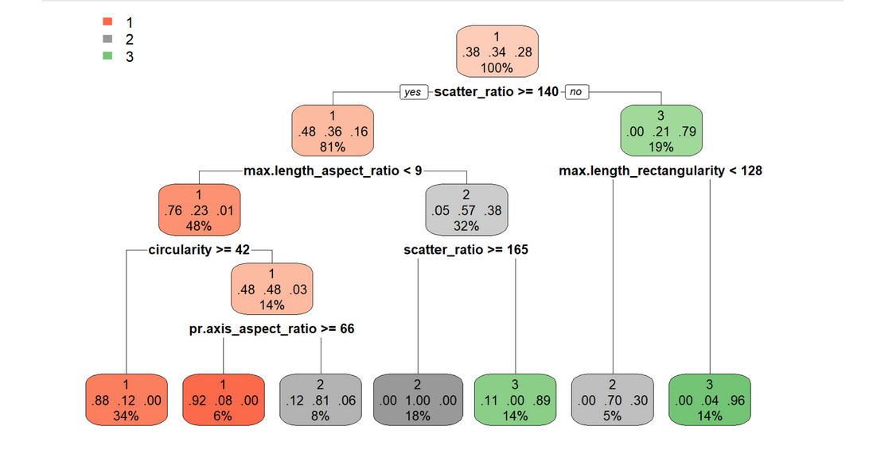
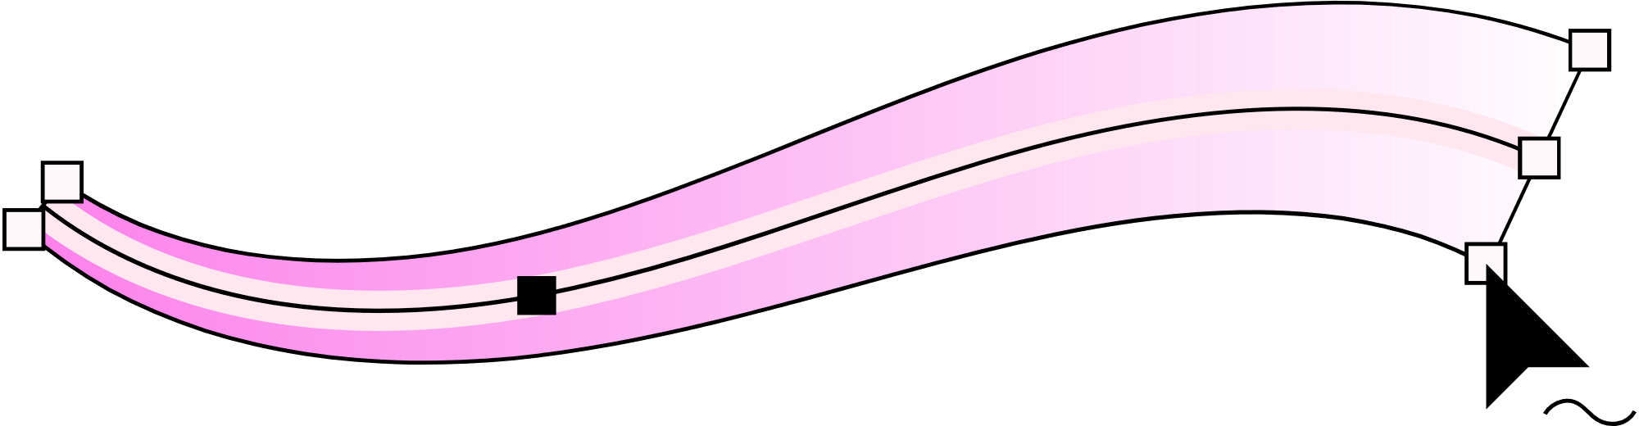

Slide 12

Clustering
Clustering is an unsupervised learning approach that revolves around grouping similar data points while maintaining a distance from dissimilar ones.In our project, the clustering method entails bringing together data points that share similarities, enabling the recognition of patterns within the dataset.

Slide 13
In this method, we experimented with three different values for k (cluster sizes) and examined the rationale behind selecting them. We utilized visuals, applied the Bcubed calculation, and further assessed the results to gain a deeper understanding. Finally, we conducted evaluations using specific metrics to determine the most suitable k size for our analysis.
What we did:

Slide 14
Findings
After experimenting with three different k sizes and analyzing visuals and evaluation methods, we determined that our dataset is best represented by 2 clusters, with minimal overlap between them.

Slide 15
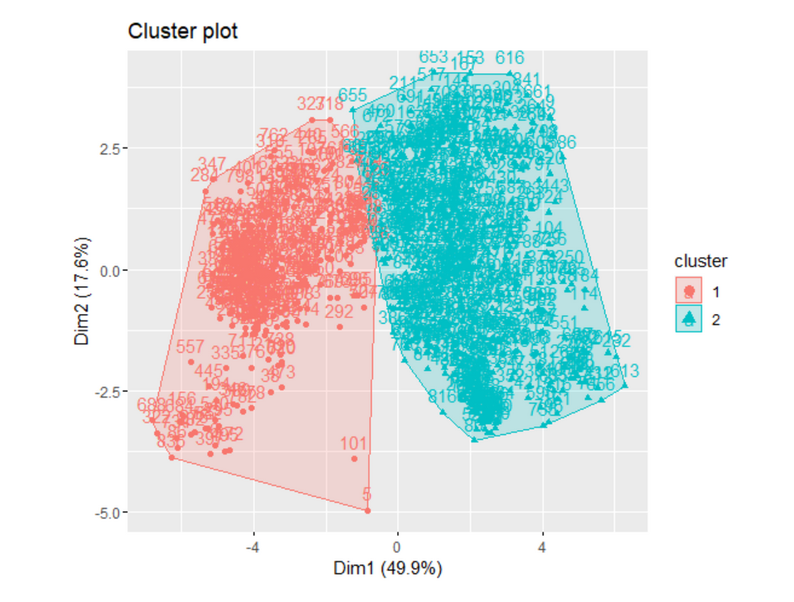
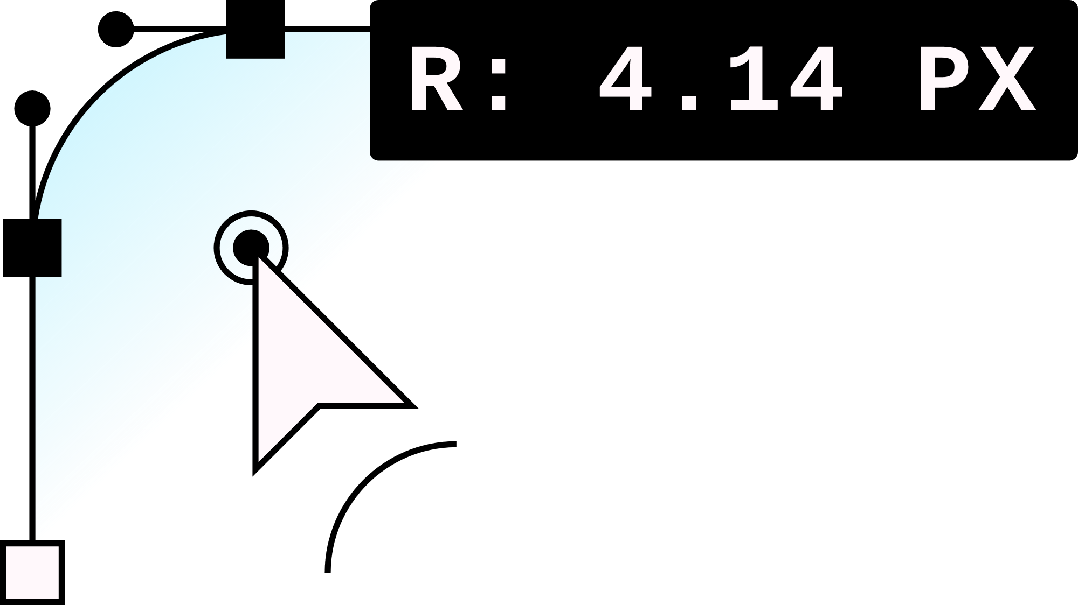
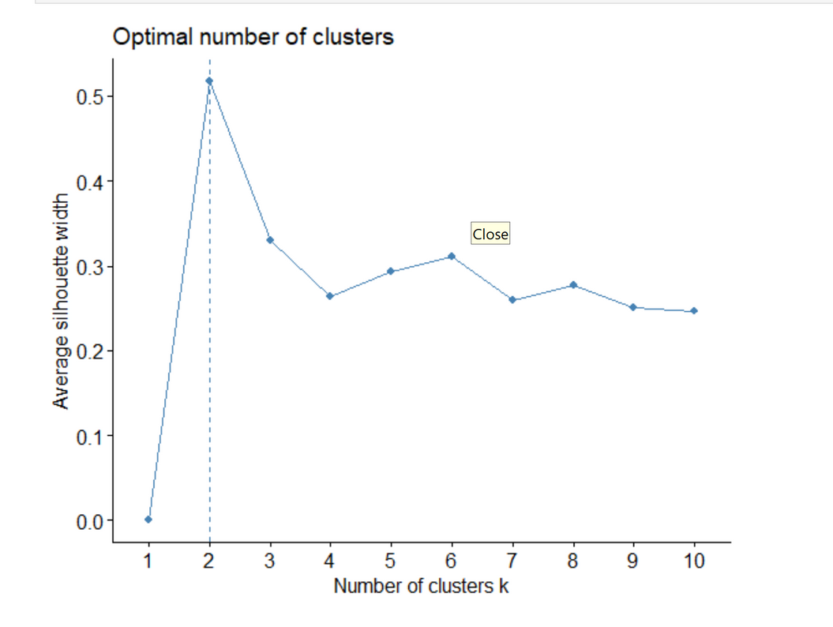

Slide 16
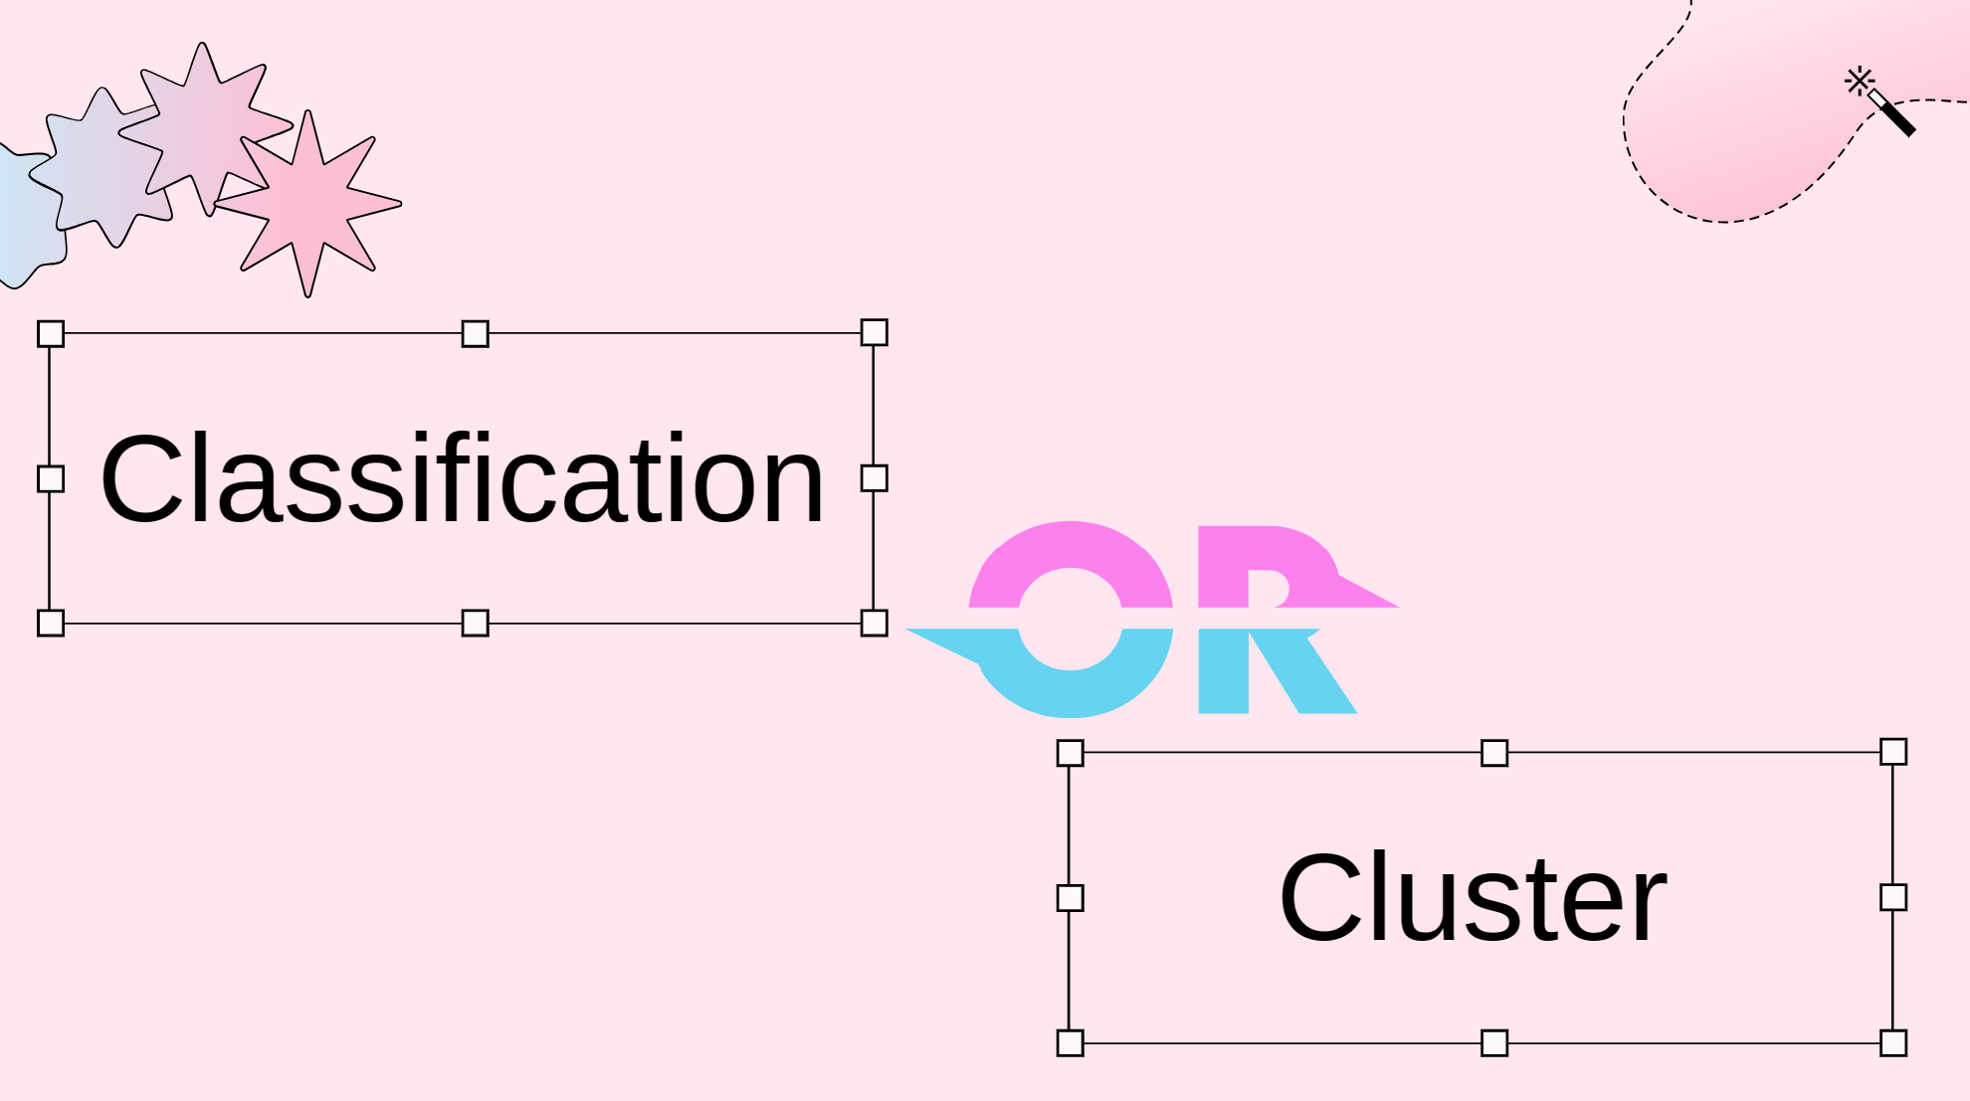

Slide 17
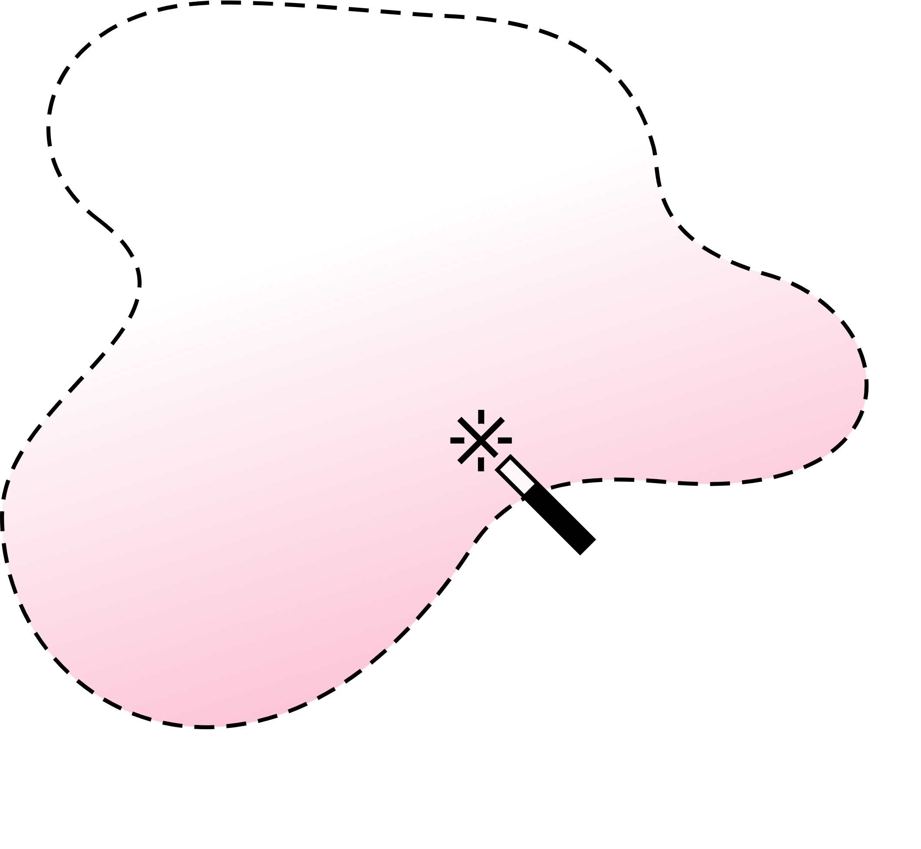
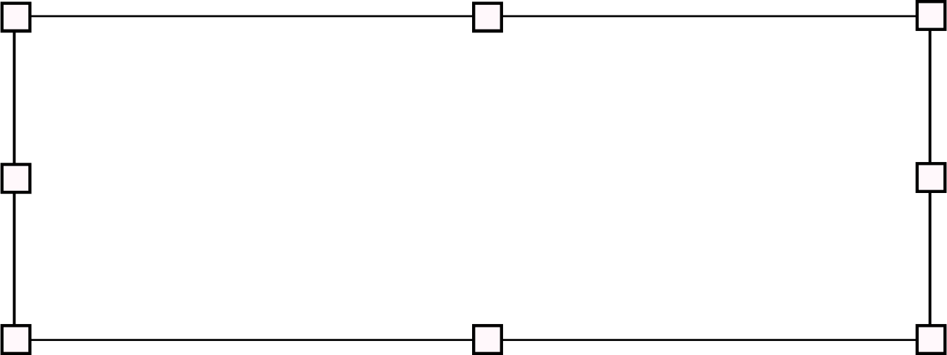
Our Team
thank you
SHAHAD ALHADDAD
LINA ALBARRAK
WEJOUD ALKHASHLAN
443203031
443200557
442200119

